Slide 1
Fragments
Week 8

Slide 2
2.1 Fragments

Slide 3
Contents
What are Fragments?

Slide 4
Fragments
(high-level view)

Slide 5
What is an Activity?
A Fragment represents a reusable portion of your app's UI. A fragment defines and manages its own layout, has its own lifecycle, and can handle its own input events.
Fragments can't live on their own.

Slide 6
What is a Fragment?
They must be hosted by an activity or another fragment. The fragment’s view hierarchy becomes part of, or attaches to, the host’s view hierarchy.

Slide 7
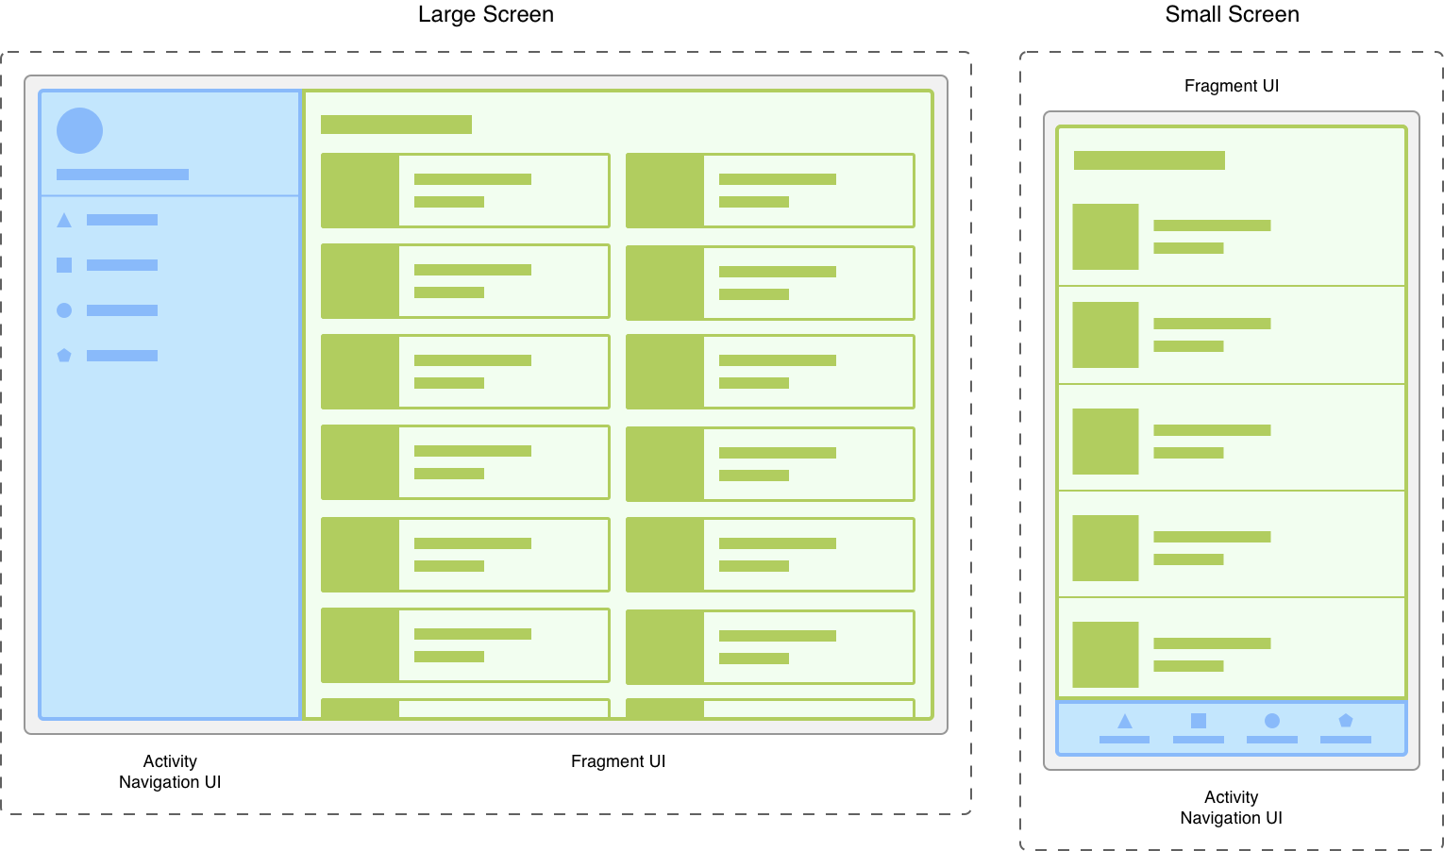
Examples of Fragments

Slide 8
END

